Slide 1
Exploration into Feeling Healthy
Christina Ling IST 565 – Final Project

Slide 2
What impacts feeling healthy: Exercise, Upbringing, or eating habits?
Data Science Question

Slide 3
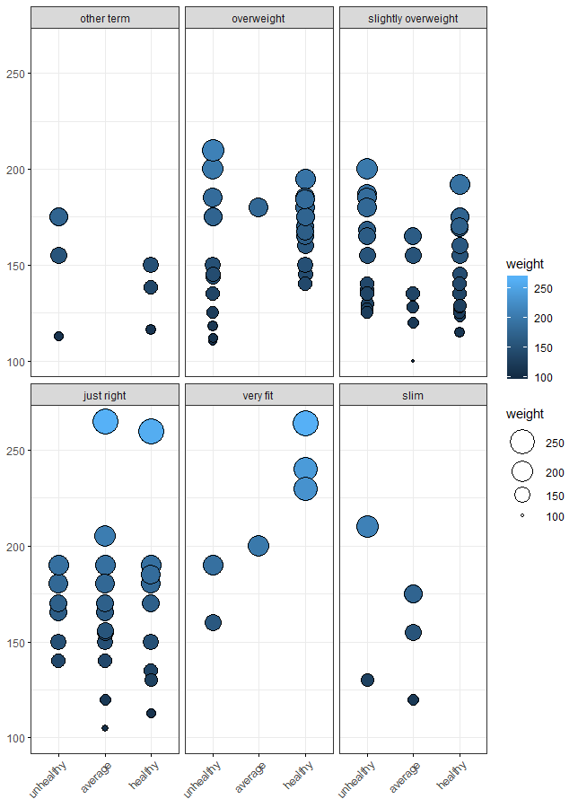
Data
Kaggle’s Food Choices
Responses to Interview
College students
Predicted Variable = Healthy Feeling
On a scale from one to ten, how healthy do you feel?

Slide 4
Association Rules Mining
Rule | Support | Confidence | Lift
coffee = espresso, cuisine = american, eating_out = 1-2 times exercise = every day parents_cooking = almost everyday | 0.104 | 0.8125 | 2.0312
gender = male marital_status = in a relationship | 0.104 | 0.7647 | 1.9118
exercise = everyday, on_off_campus = on campus, parents_cook = almost everyday self_perception_weight = overweight | 0.104 | 0.7647 | 1.9118
breakfast=cereal, cuisine=american, eating_out=1-2 times, exercise=everyday, parents_cook=almost everyday, sports=yes | 0.104 | 0.7647 | 1.9118
Finding & Analysis
Exercising almost everyday or more
Parents cooking almost everyday
Metrics
Low Support
High Lift
Conclusion
Foundation
Subdivide the Data

Slide 5
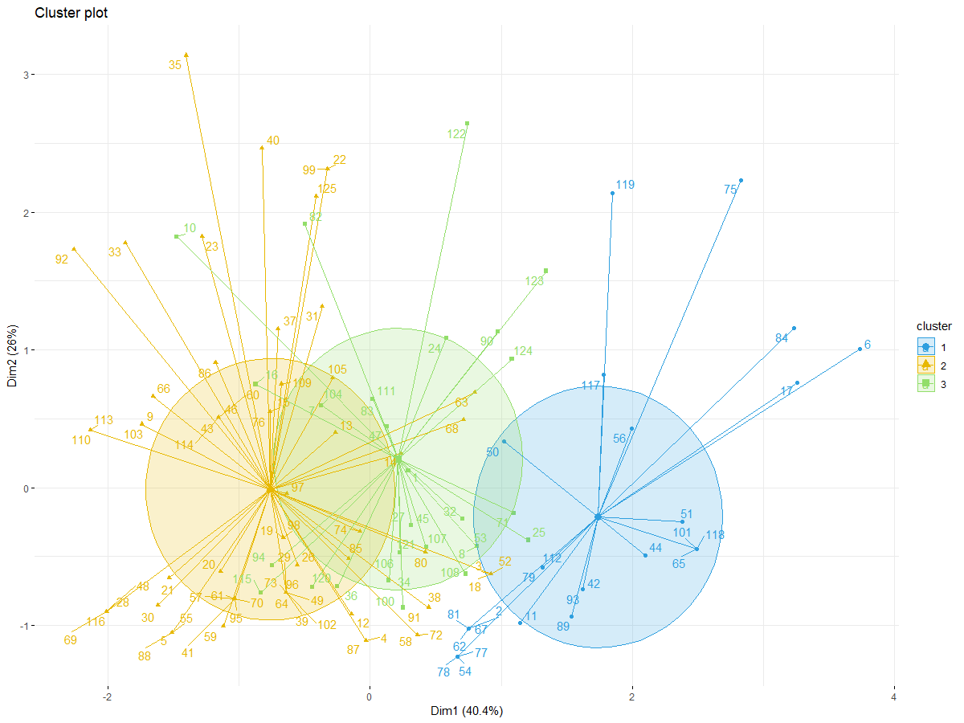
Clustering
Exercise Cluster
Finding & Analysis
Exercise has the best clustering
Results
 | 1 | 2 | 3
Unhealthy | 9 | 25 | 14
Average | 6 | 13 | 8
Healthy | 11 | 30 | 9
Conclusion
Not accurate
Difficult Separating the Clusters Correctly

Slide 6
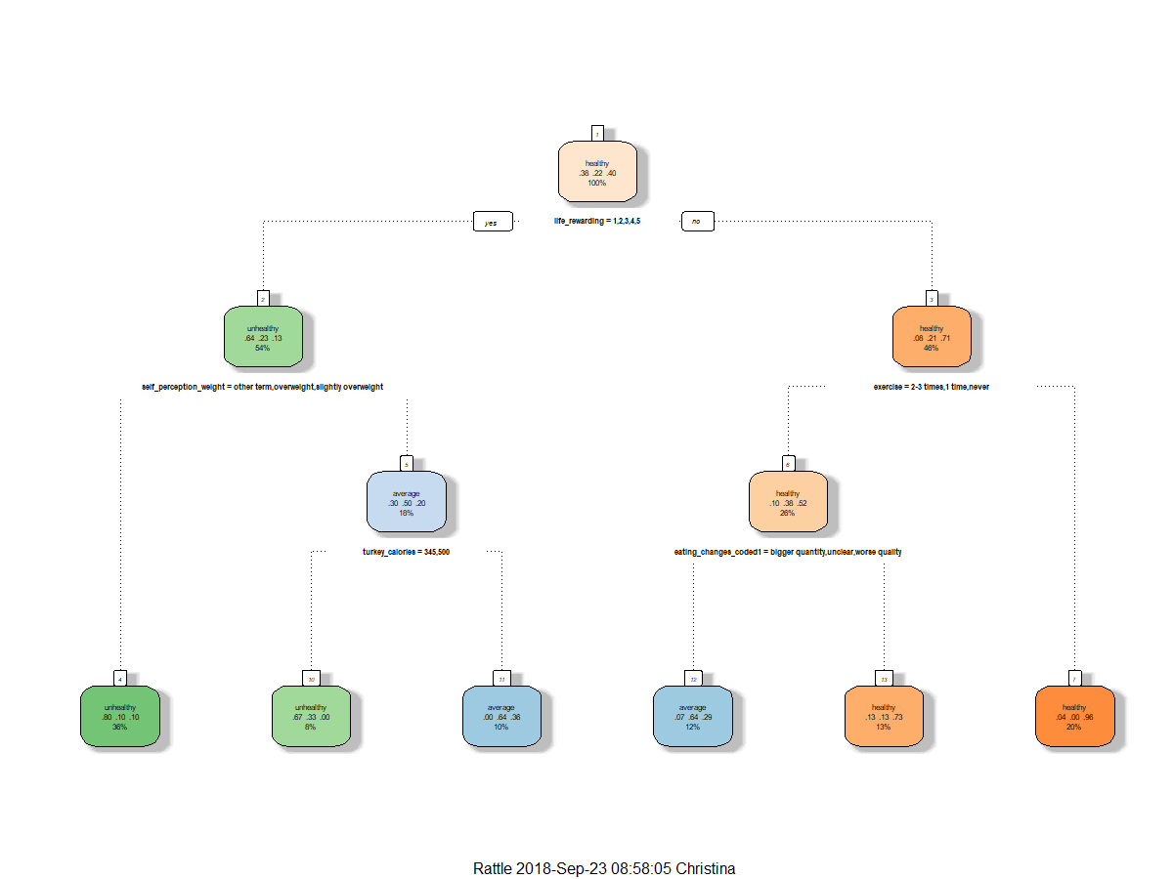
Decision Tree
All Data Decision Tree
Finding & Analysis
Exercising everyday or almost everyday
Results
predict |  | U | A | H
 | Unhealthy | 4 | 1 | 0
 | Average | 1 | 0 | 2
 | Healthy | 0 | 1 | 3
Conclusion
Accuracy = 0.583
Follows Exercise Theme

Slide 7
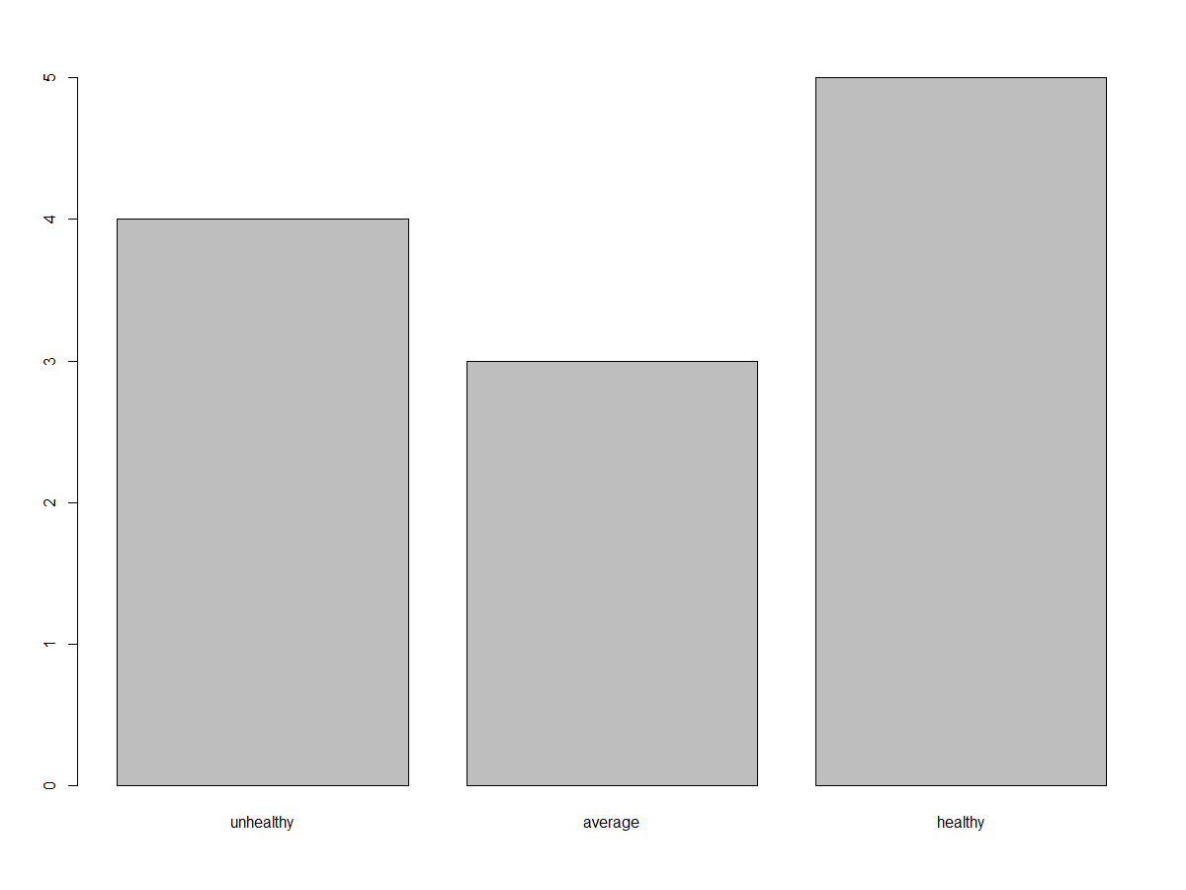
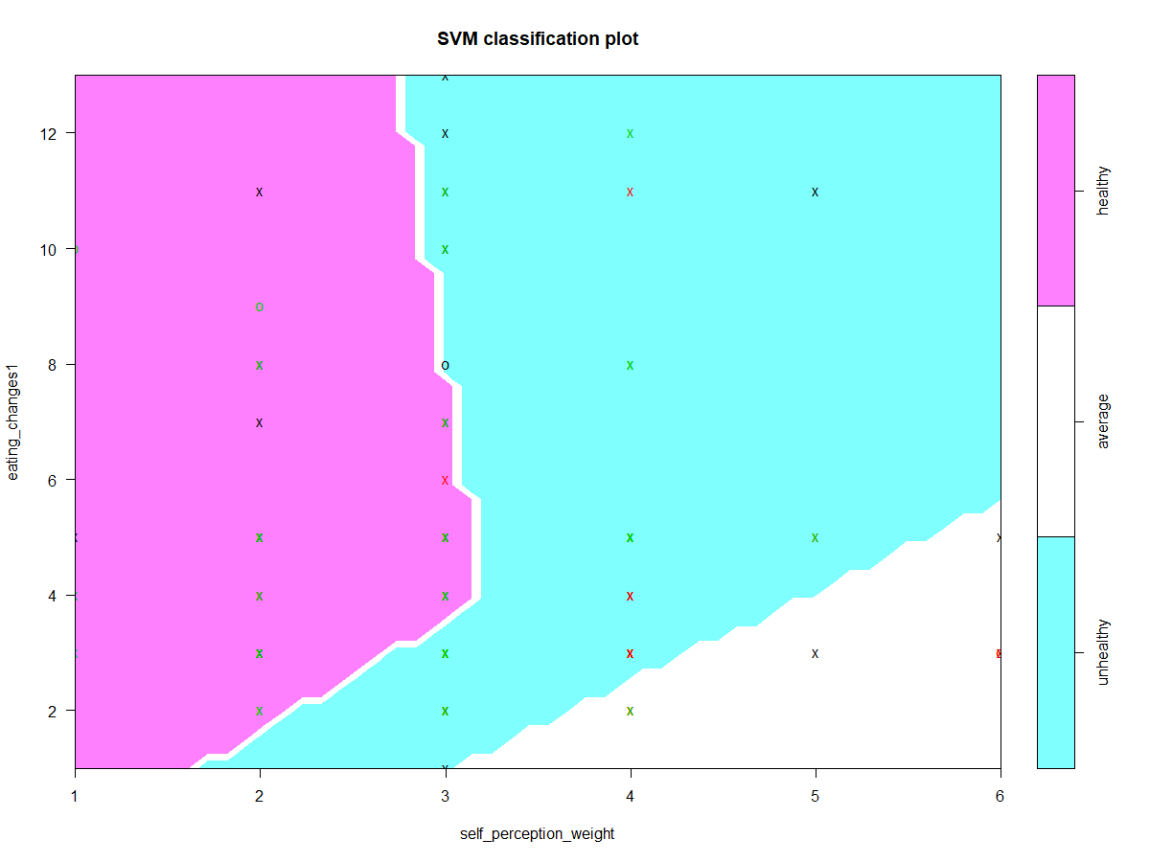
Naïve Bayes
SVM
Finding & Analysis
Eating Habits (Nutrition Habits) Performed Best
Upbringing was Second Best
Finding & Analysis
Eating Habits (Nutrition Habits) Performed Best
Results
Results
predict |  | U | A | H
 | Unhealthy | 1 | 1 | 2
 | Average | 1 | 2 | 0
 | Healthy | 1 | 0 | 4
predict |  | U | A | H
 | Unhealthy | 3 | 0 | 0
 | Average | 0 | 2 | 2
 | Healthy | 1 | 0 | 3
Conclusion
Accuracy = 0.667
Conclusion
Accuracy = 0.667

Slide 8
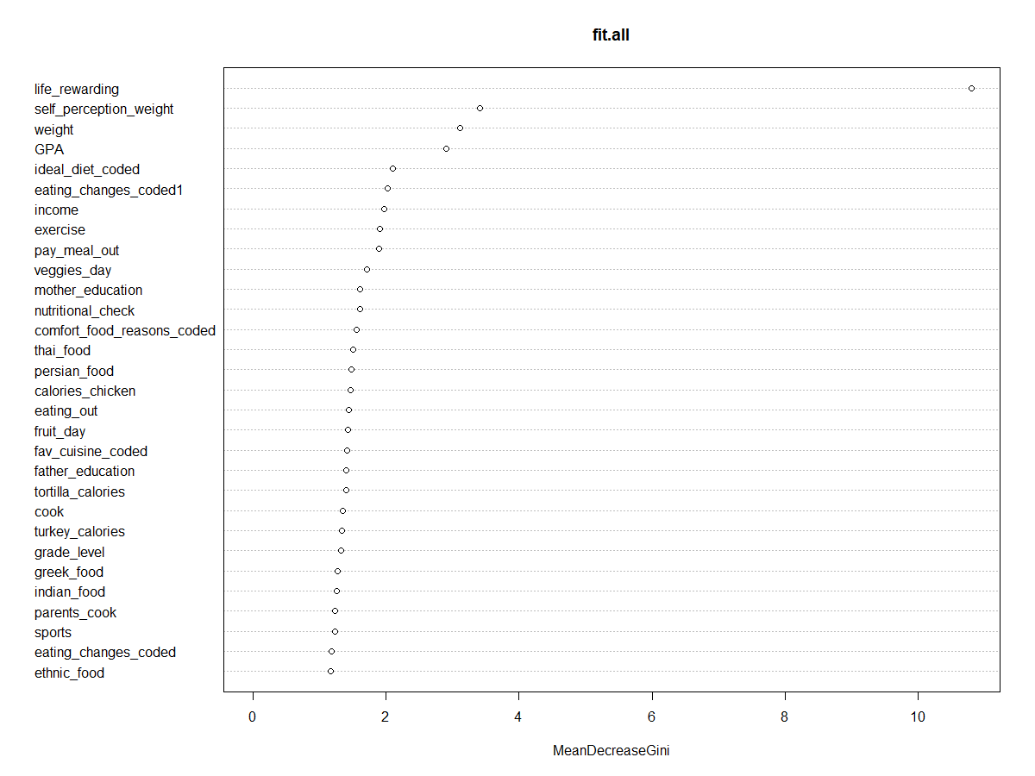
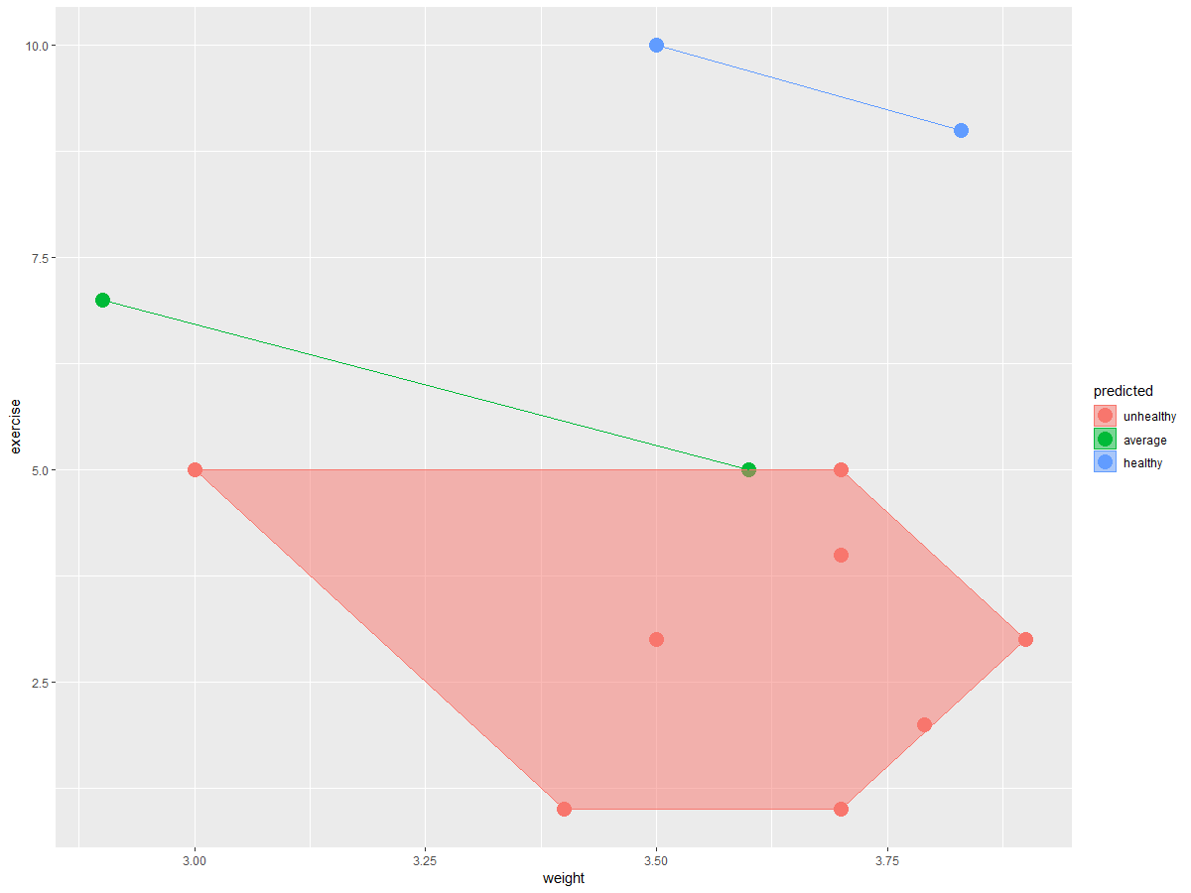
Random Forest
kNN
Finding & Analysis
Life Rewarding
Exercise
Finding & Analysis
Exercise Performed Best
Results
Results
predict |  | U | A | H
 | Unhealthy | 2 | 3 | 1
 | Average | 0 | 0 | 0
 | Healthy | 0 | 2 | 4
predict |  | U | A | H
 | Unhealthy | 2 | 1 | 0
 | Average | 0 | 0 | 0
 | Healthy | 5 | 0 | 4
Conclusion
Accuracy = 0.500
Support Results from Previous Analysis
Conclusion
Accuracy = 0.500
Support Results from Previous Analysis

Slide 9
Conclusion
Healthy Feeling
Exercise
Life is Rewarding Feeling
Upbringing
Eating Habits
Dieting and Nutrition Habits

